Slide 1
EVALUATION OF SUPERVOXEL SEGMENTATION APPROACHES ON 3D LIDAR DATASET
Submitted By
K. SURENDAR (810015104092)
S. SYED IMTHIYAAS (810015104096)
Under the guidance of
Mrs. R.S. RAMPRIYA
Dept of Computer Science and Engineering
AU-BIT Campus - Trichy

Slide 2
CONTENTS
Objective
Introduction
Existing System
Proposed system
System Architecture
Modules
Algorithm
Outcomes
References

Slide 3
OBJECTIVE
3D point clouds are used to represent shape, size, position and orientation of objects in space.
There is a need of relevant methods to provide 3D data with meaningful attributes that characterize and provide significance to the objects represented in 3D.
Segmentation is the process of grouping point clouds into multiple homogeneous regions with similar properties

Slide 4
INTRODUCTION
3D point clouds
LiDAR
Segmentation

Slide 5
EXISTING SYSTEM
Support Vector Machines
CNN
(Convolutional Neural Networks)
Emprical
Approach
Train an algorithm to Classify Features

Slide 6
PROPOSED SYSTEM
Min Cut Based , Region Growing
CPC based Supervoxel segmentation
VCCS to create Supervoxels
Evaluation of Supervoxel Segmentation

Slide 7
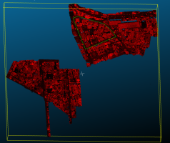
SYSTEM ARCHITECTURE
Supervoxel Creation & Clustering
Preprocessing
Octree
Voxel
Voxels
ground
VCCS
Outdoor scene
DTM Filter
3D Point Cloud
Supervoxels
Un ground
Evaluation of Supervoxel Segmentation
Segmented Point cloud Data
Segmentation using CPC

Slide 8
MODULES
Preprocessing
Supervoxel Clustering
Segmentation using CPC
Evaluation of Segmentations

Slide 9
Preprocessing Module
Raw 3D Point Cloud Data
Progressive Morphological Filter
Non-Ground 3D Point Cloud Data

Slide 10
VCCS Algorithm Module (Supervoxel Clustering)
Voxelized Space
Seed Voxels Selection
Supervoxel feature vector initialization
Geometrically constrained & disjoint Supervoxels
Centroid Updation & Stabilization
Distance computation

Slide 11
CPC ALGORITHM MODULE
Supervoxels
Identify Local connectivity and cuts between adjacent patches
Establish Geometrical Connectivity between neighbouring Supervoxels
Segmented Supervoxels
Compare & Merge two neighbouring Supervoxels if satisfies Convexity criteria
Compute Centroid & Normals for individual Supervoxels

Slide 12
REGION GROWING
Merge two Points that are close to smoothness constraint
Comparison of angle between normals
Seed Point is Picked for Segmentation
If the curvature is less than threshold value then this point is added to the seeds.
If the angle is less than threshold value then current point is added to the current region.
Current Seed is removed and clusters are formed

Slide 13
Minimum cut Based Segmentation
Assign Weights to each edges of Cloud points
Divided into two sets
Foreground and background
Every vertex of the graph that corresponds to the point is connected with source and sink with the edges
Distance to the Center is calculated and min cut is made
Set Data cost and Background Penalty

Slide 14
VCCS Algorithm (Supervoxel Clustering)
Step 1: Load the input voxel cloud based on the input argument.
Step 2: Initialize the data structure(Multi-map) to extract the Supervoxels.
Repeat
Step 3: Extract the Supervoxel adjacency list (in the form of a Multi-map of label adjacencies) for each seed-voxel.
Until all the voxels are processed.
Step 4: Iterate through the Multi-map, to create a point cloud of the centroids of each Supervoxel's neighbours.
Step 5: Create a Supervoxel graph using a drawing helper function to draw a star polygon mesh of the Supervoxel centroid to all of its neighbors centroids.

Slide 15
CPC Algorithm (3D Segmentation)
Repeat
Step 1: Identify Local connectivity and cuts between adjacent patches.
Step 2: Establish Geometrical Connectivity between neighbouring Supervoxels.
Step 3: Compute Centroid & Normals for individual Supervoxels.
Step 4: Compare two neighbouring Supervoxels for defining Connectivity between them.
Step 5: Merge two Supervoxels if satisfies Convexity criteria.
Until all Supervoxels are processed.

Slide 16
CODE - DIGITAL TERRAIN MODEL
// Create the filtering object
pcl::ProgressiveMorphologicalFilter<pcl::PointXYZ> pmf;
pmf.setInputCloud (cloud); a
pmf.setMaxWindowSize (20);
pmf.setSlope (1.0f);
pmf.setInitialDistance (0.5f);
pmf.setMaxDistance (3.0f);
pmf.extract (ground->indices);
// Create the filtering object
pcl::ExtractIndices<pcl::PointXYZ> extract;
extract.setInputCloud (cloud);
extract.setIndices (ground);
extract.filter (*cloud_filtered);

Slide 17
CODE – VCCS SUPERVOXEL CLUSTERING
std::multimap<uint32_t,uint32_t>::iterator label_itr = supervoxel_adjacency.begin ();
for ( ; label_itr != supervoxel_adjacency.end (); ) {
//First get the label uint32_t supervoxel_label = label_itr->first;
//Now get the supervoxel corresponding to the label
pcl::Supervoxel<PointT>::Ptr supervoxel = supervoxel_clusters.at (supervoxel_label);
//Now we need to iterate through the adjacent supervoxels and make a point cloud of them
PointCloudT adjacent_supervoxel_centers;
std::multimap<uint32_t,uint32_t>::iterator adjacent_itr = supervoxel_adjacency.equal_range (supervoxel_label).first;
for ( ; adjacent_itr!=supervoxel_adjacency.equal_range (supervoxel_label).second; ++adjacent_itr) {
pcl::Supervoxel<PointT>::Ptr neighbor_supervoxel = supervoxel_clusters.at (adjacent_itr->second);
adjacent_supervoxel_centers.push_back (neighbor_supervoxel->centroid_);
}
//Now we make a name for this polygon std::stringstream ss;
ss << "supervoxel_" << supervoxel_label;
//It generates a "star" polygon mesh from the points given
addSupervoxelConnectionsToViewer (supervoxel->centroid_, adjacent_supervoxel_centers, ss.str (), viewer);
//Move iterator forward to next label label_itr = supervoxel_adjacency.upper_bound (supervoxel_label);
}

Slide 18
CODE – CPC 3D SEGMENTATION
template <typename PointT> void
class CPCSegmentation : public LCCPSegmentation<PointT>{
public: CPCSegmentation ();
virtual ~CPCSegmentation ();
void segment ();
inline void setCutting ( ) {
max_cuts_ = max_cuts;
min_segment_size_for_cutting_ = cutting_min_segments;
min_cut_score_ = cutting_min_score;
use_local_constrains_ = locally_constrained;
use_directed_weights_ = directed_cutting;
use_clean_cutting_ = clean_cutting } inline void setRANSACIterations (const uint32_t ransac_iterations) {
ransac_itrs_ = ransac_iterations;
}

Slide 19
CODE – REGION GROWING
pcl::RegionGrowing<pcl::PointXYZ, pcl::Normal> reg;
reg.setMinClusterSize (50);
reg.setMaxClusterSize (1000000);
reg.setSearchMethod (tree);
reg.setNumberOfNeighbours (30);
reg.setInputCloud (cloud);
//reg.setIndices (indices);
reg.setInputNormals (normals);
reg.setSmoothnessThreshold (3.0 / 180.0 * M_PI);
reg.setCurvatureThreshold (1.0);
std::vector <pcl::PointIndices> clusters
reg.extract (clusters);
std::cout << "Number of clusters is equal to " << clusters.size () << std::endl;
std::cout << "First cluster has " << clusters[0].indices.size () << " points." << endl;
std::cout << "These are the indices of the points of the initial" <<
std::endl << "cloud that belong to the first cluster:" << std::endl;
int counter = 0;
while (counter < clusters[0].indices.size ())
{
std::cout << clusters[0].indices[counter] << ", ";
counter++;
pcl::RegionGrowing<pcl::PointXYZ, pcl::Normal> reg;
reg.setMinClusterSize (50);
reg.setMaxClusterSize (1000000);
reg.setSearchMethod (tree);
reg.setNumberOfNeighbours (30);
reg.setInputCloud (cloud);
//reg.setIndices (indices);
reg.setInputNormals (normals);
reg.setSmoothnessThreshold (3.0 / 180.0 * M_PI);
reg.setCurvatureThreshold (1.0);
std::vector <pcl::PointIndices> clusters
reg.extract (clusters);
std::cout << "Number of clusters is equal to " << clusters.size () << std::endl;
std::cout << "First cluster has " << clusters[0].indices.size () << " points." << endl;
std::cout << "These are the indices of the points of the initial" <<
std::endl << "cloud that belong to the first cluster:" << std::endl;
int counter = 0;
while (counter < clusters[0].indices.size ())
{
std::cout << clusters[0].indices[counter] << ", ";
counter++;

Slide 20
CODE- MIN CUT BASED SEGMENTATION
// Min-cut clustering object.
pcl::MinCutSegmentation<pcl::PointXYZ> clustering;
clustering.setInputCloud(cloud);
// Create a cloud that lists all the points that we know belong to the object
// (foreground points). We should set here the object's center.
pcl::PointCloud<pcl::PointXYZ>::Ptr foregroundPoints(new pcl::PointCloud<pcl::PointXYZ>());
pcl::PointXYZ point;
point.x = 100.0;
point.y = 100.0;
point.z = 100.0;
foregroundPoints->points.push_back(point);
clustering.setForegroundPoints(foregroundPoints);
// Set sigma, which affects the smooth cost calculation. It should be
// set depending on the spacing between points in the cloud (resolution).
clustering.setSigma(0.05);
// Set the radius of the object we are looking for.
clustering.setRadius(0.20);
// Set the number of neighbors to look for. Increasing this also increases
// the number of edges the graph will have.
clustering.setNumberOfNeighbours(20);
// Set the foreground penalty. It is the weight of the edges
clustering.setSourceWeight(0.6);
std::vector <pcl::PointIndices> clusters;clustering.extract(clusters);std::cout << "Maximum flow is " << clustering.getMaxFlow() << "." << std::endl;
// Min-cut clustering object.
pcl::MinCutSegmentation<pcl::PointXYZ> clustering;
clustering.setInputCloud(cloud);
// Create a cloud that lists all the points that we know belong to the object
// (foreground points). We should set here the object's center.
pcl::PointCloud<pcl::PointXYZ>::Ptr foregroundPoints(new pcl::PointCloud<pcl::PointXYZ>());
pcl::PointXYZ point;
point.x = 100.0;
point.y = 100.0;
point.z = 100.0;
foregroundPoints->points.push_back(point);
clustering.setForegroundPoints(foregroundPoints);
// Set sigma, which affects the smooth cost calculation. It should be
// set depending on the spacing between points in the cloud (resolution).
clustering.setSigma(0.05);
// Set the radius of the object we are looking for.
clustering.setRadius(0.20);
// Set the number of neighbors to look for. Increasing this also increases
// the number of edges the graph will have.
clustering.setNumberOfNeighbours(20);
// Set the foreground penalty. It is the weight of the edges
clustering.setSourceWeight(0.6);
std::vector <pcl::PointIndices> clusters;clustering.extract(clusters);std::cout << "Maximum flow is " << clustering.getMaxFlow() << "." << std::endl;

Slide 21

IMPLEMENTATION - DATASETS
OUTDOOR DATASET
http://www2.isprs.org/commissions/comm3/wg4/2d-sem-label-vaihingen.html

Slide 22
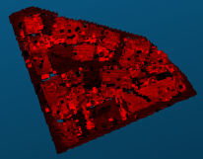
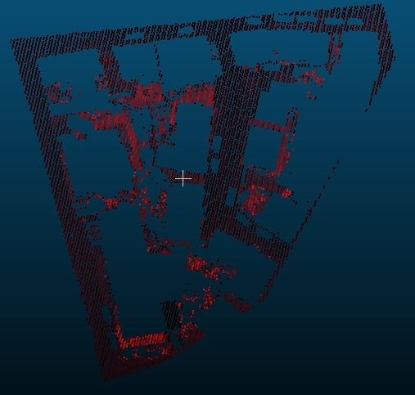
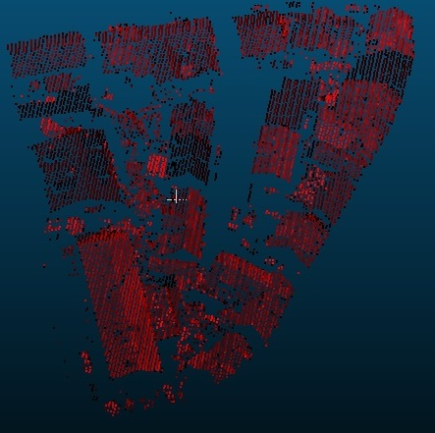
IMPLEMENTATION :: OUTDOOR SCENE
PREPROCESSING
CLIPPED DATASET | GROUND DATA | NON-GROUND DATA

Slide 23
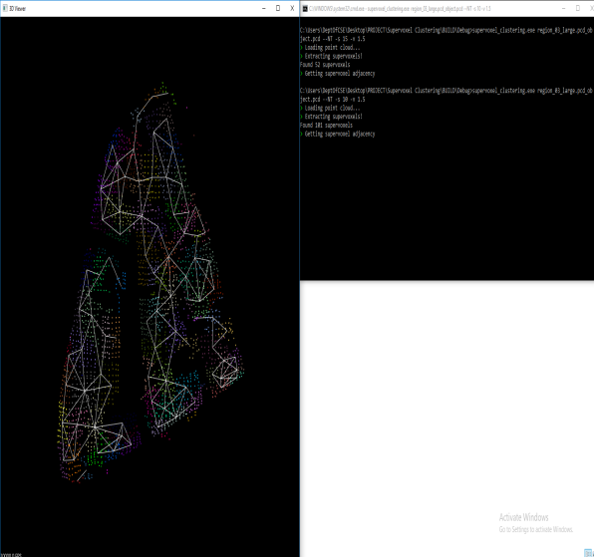
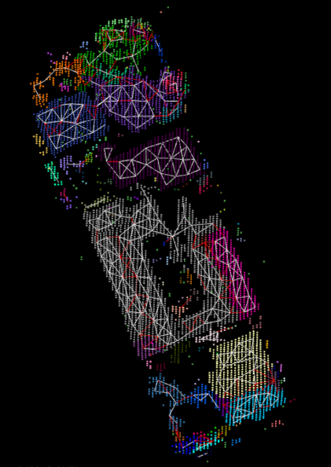
SUPERVOXEL CLUSTERING

Slide 24
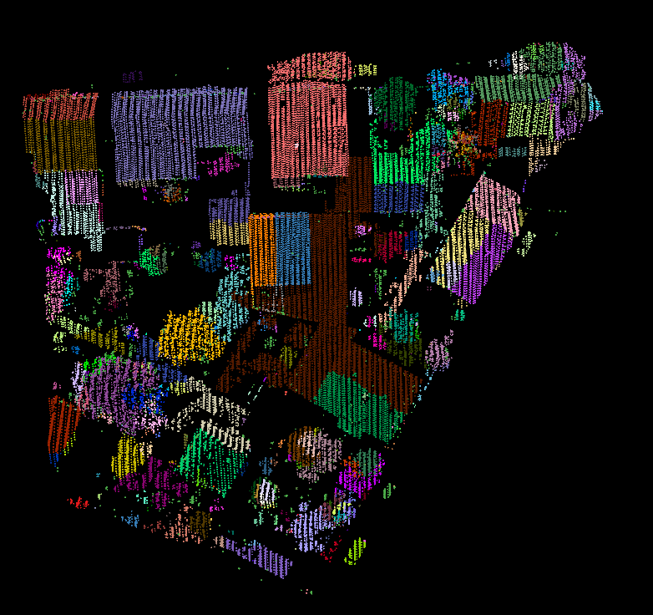
LCCP SEGMENTATION
Vaihingen dataset LCCPSegmentation:
Study Area-R_Seed=3.75 & R_Voxel=0.5

Slide 25
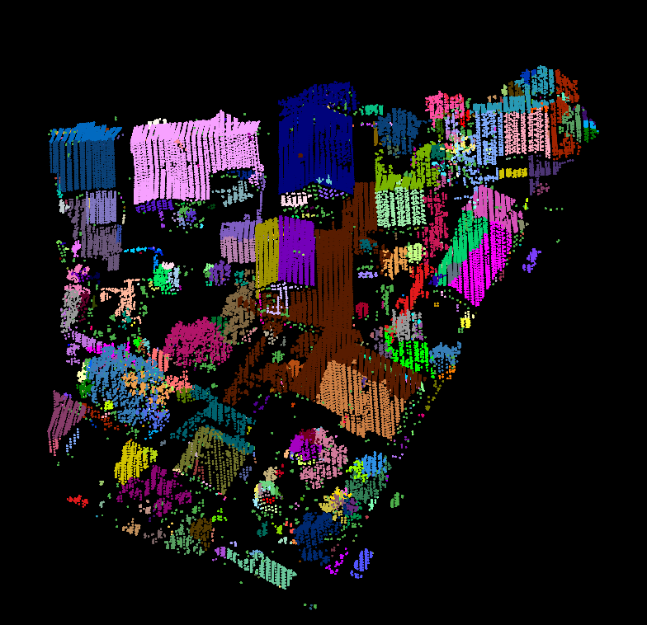
CPC SEGMENTATION
Vaihingen dataset CPCSegmentation:
Study Area-R_Seed=10 & R_Voxel=1.5

Slide 26
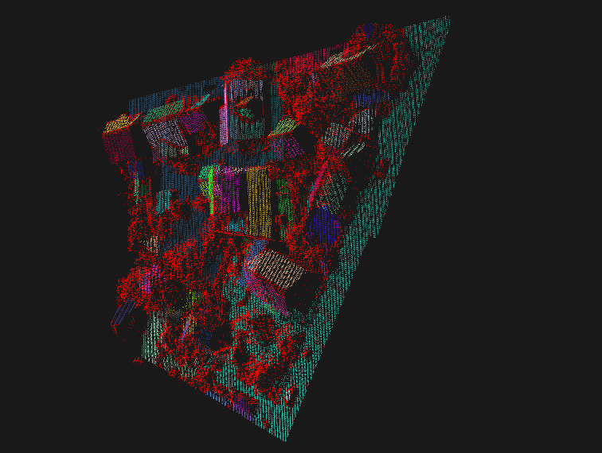
REGION GROWING

Slide 27
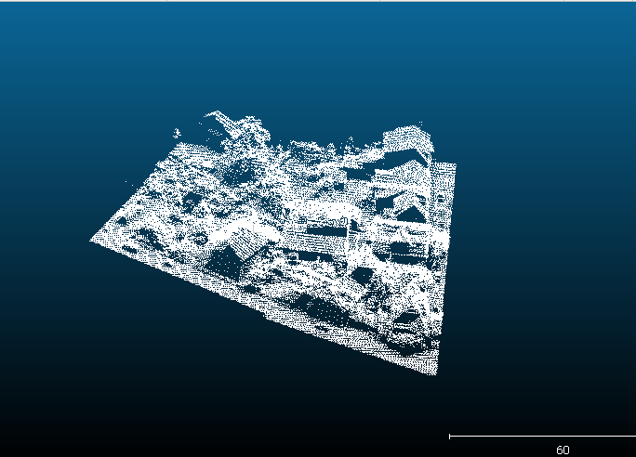
MINIMUM CUT BASED SEGMENTATION

Slide 28
SOFTWARES USED
Cloud Compare
Point Cloud Library(pcl 1.8.0)
Visual Studio 2013
C Make 3.7.1

Slide 29
REFERENCES
Charalambos Poullis, Member, IEEE, “A Framework for Automatic Modeling from Point cloud Data”, IEEE Xplore, 2017.
Dong Chen, Liqiang Zhang, P.Takis Mathiopoulos, Senior Member IEEE, Xianfeng Huang, “A Methodology for Automated Segmentation and Reconstruction of Urban 3-D Buildings from ALS Point Clouds”, IEEE, 2017.
Anandakumar M. Ramiya, Rama Rao Nidamanuri & Ramakrishnan Krishnan, “Semantic labelling of urban point cloud data”, The International Archives of the Photogrammetry, Remote Sensing and Spatial Information Sciences, 2018.
Anandakumar M. Ramiya, Rama Rao Nidamanuri & Ramakrishnan Krishnan, “Object-oriented semantic labelling of spectral–spatial LiDAR point cloud for urban land cover classification and buildings detection”, Geocarto International (Taylor & Francis group), 2017.
Anandakumar M. Ramiya, Rama Rao Nidamanuri & Ramakrishnan Krishnan, “Segmentation based building detection approach from LiDAR point cloud”, Egyptian Journal of Remote Sensing and Space Science, 2018.
Anandakumar M. Ramiya, Rama Rao Nidamanuri & Ramakrishnan Krishnan, “A supervoxel-based spectro-spatial approach for 3D urban point cloud labelling”, International Journal of Remote Sensing, 2018.

